Slide 1

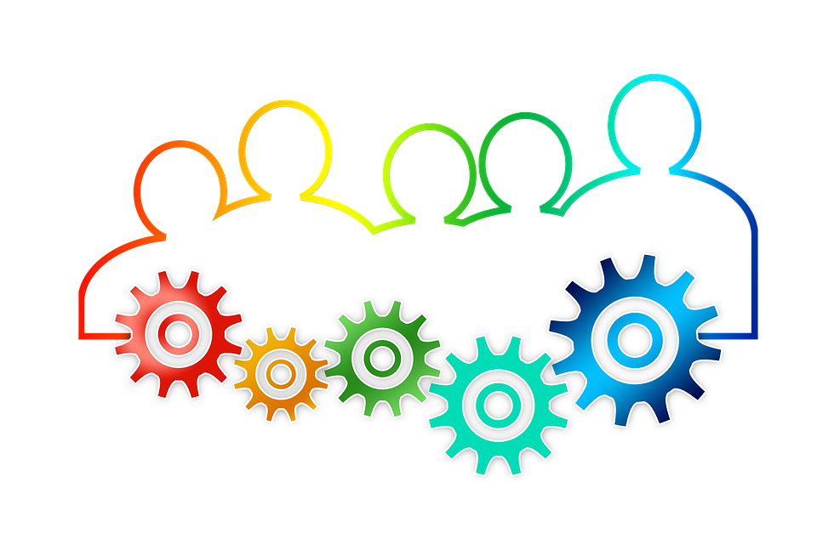
Agile Adoption: Scrum-Agile vs. Waterfall Approaches
Seda Cowan June 2025

Slide 2

Scrum-Agile Roles
Scrum Master: Facilitates team processes, removes blockers, and ensures Scrum practices are followed. This role is essential for maintaining team focus, promoting continuous improvement, and upholding the principles of Agile throughout each sprint.
Product Owner: Manages the product backlog, prioritizes user stories, and represents customer needs. The Product Owner ensures the team builds features that deliver maximum business value and aligns development with evolving user needs.
Development Team: A cross-functional group that includes Developers, Testers, and Designers who collaboratively build, test, and refine product increments. Their diverse skills allow for rapid iteration, ongoing quality assurance, and integrated feature delivery during each sprint.
This Photo by Unknown Author is licensed under CC BY-SA-NC

Slide 3
Agile Across the Software Development Life Cycle
Requirements: Captured as evolving user stories. This phase is crucial because it allows for continuous refinement based on client input, helping the team stay aligned with real user needs.
Design & Development: Iterative across sprints, with regular feedback. This ensures early validation of features and allows the team to make improvements incrementally.
Testing: Ongoing and embedded throughout development. Continuous testing helps catch issues early and supports higher product quality.
Deployment & Feedback: Regular releases and retrospectives. This phase supports continuous delivery and improvement based on stakeholder feedback.
Note: Agile supports change and user input at every phase (Schwaber & Sutherland, 2020).

Slide 4
What If We Used Waterfall Instead?
Waterfall follows a strict sequence: Requirements → Design → Development → Testing → Deployment.
Waterfall has limited flexibility: Changes late in development are costly and require restarting earlier phases.
In the SNHU Travel project, adapting to the wellness theme and implementing a slideshow mid-project would have required revisiting the requirement and design phases. This could have delayed deployment significantly.
Waterfall is best suited for projects with fixed requirements and minimal expected change. However, for evolving or user-driven projects like SNHU Travel, it introduces risk due to its rigidity.

Slide 5
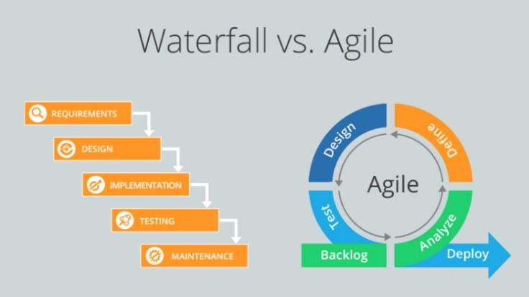
When to Use Waterfall vs. Agile
Agile is better for:
Projects with evolving requirements
Need for continuous feedback
Fast-paced delivery
Waterfall fits:
Clearly defined requirements
Minimal client input needed during build
Project Example: Agile allowed us to pivot from top-rated destinations to wellness themes smoothly (Rubin, 2013).
This Photo by Unknown Author is licensed under CC BY-NC-ND

Slide 6
References
Beck, K., Beedle, M., van Bennekum, A., … Thomas, D. (2001). Manifesto for agile software development. https://agilemanifesto.org/
Larman, C., & Vodde, B. (2016). Large-scale Scrum: More with LeSS. Addison-Wesley.
Petersen, K., Wohlin, C., & Baca, D. (2019). Agile work environment and team collaboration: Information and Software Technology, 113, 90–103.
Rubin, K. S. (2013). Essential Scrum: A practical guide to the most popular agile process. Addison-Wesley.
Schwaber, K., & Sutherland, J. (2020). The Scrum Guide. https://scrumguides.org/

